Slide 1
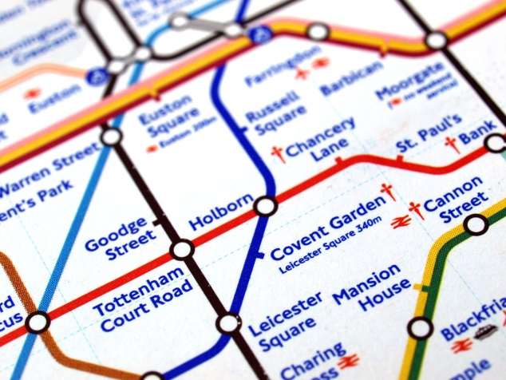
Measuring PM_{2.5}, particle number and carbon black concentration on the London Underground
Frank Kelly, James Smith, David Green, Sean Beevers and Ben Barratt
King’s College London
SETAC Europe 2015
Barcelona, 6th May 2015

Slide 2
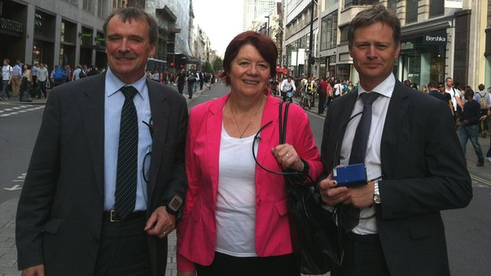
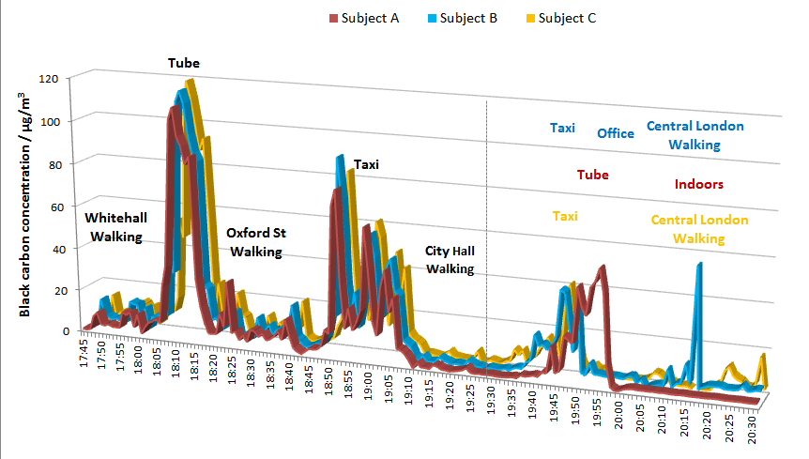
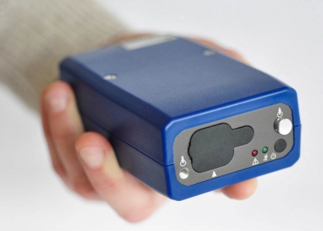
UK Environmental Audit Committee
Notes:
Joan Walley
Mike Caine
Mathew Walford

Slide 3
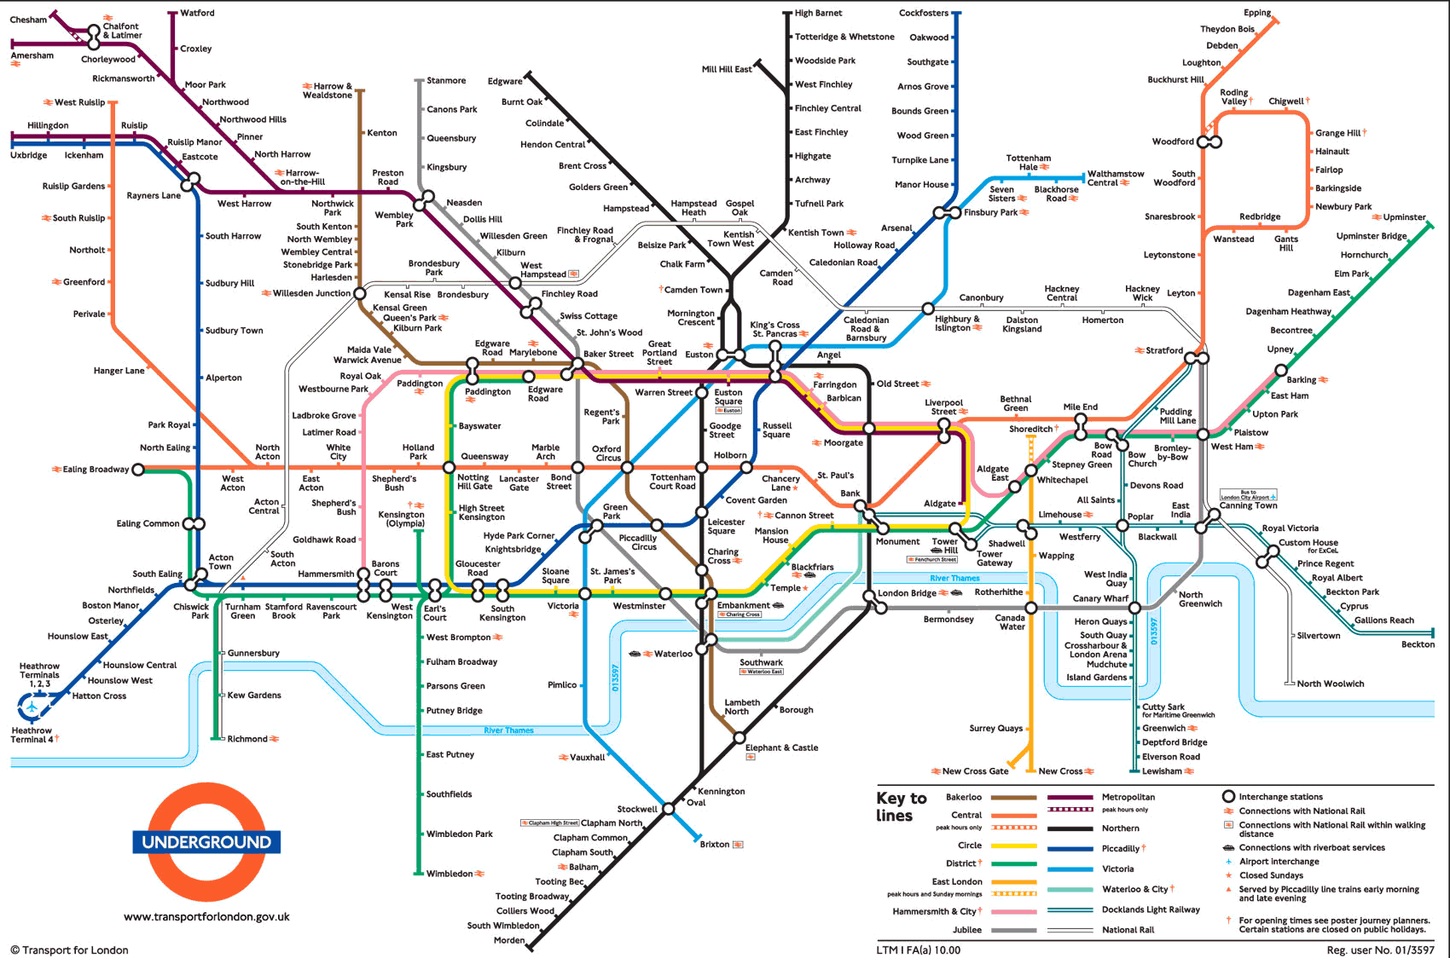
The London Underground (the ‘tube’)

Slide 4
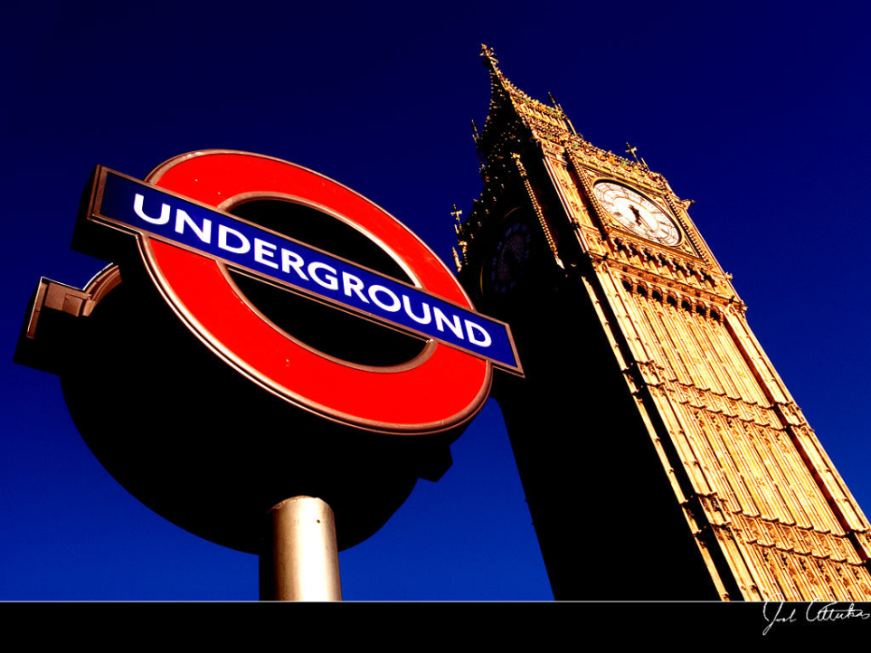
The London Underground (the ‘tube’)
The world’s oldest rapid transit system, incorporating the world's first underground railway, the Metropolitan Railway, which opened in 1863.
The system serves 270 stations and has 402 kilometres of track, 52% of which is above ground.
First line to operate underground electric traction trains in 1890.
The network has expanded to 11 lines, and in 2012/13 carried 1.23 billion passengers, making it the 12th busiest transit system.

Slide 5
Background
Passenger exposure is under-researched, limited to occupational-health research that has focused on drivers’ shift-time exposure, and a small number of studies typically focused on comparing urban transport modes.
Adams et al. (2001) sampled on the Bakerloo, Northern and District lines measuring PM_{2.5} concentrations.
Seaton et al. (2005) sampled on the Central, Northern and Victoria lines, and at three stations, measuring PM_{2.5} and particle number concentration

Slide 6
Aims
Map PM concentrations across the entire LU network
Derive monitor-specific calibration factors for iron-rich PM typical in underground transit systems.
Better characterize the chemical and physical properties of particulate matter
Improve understanding of relationships between particulate levels and
depth below ground,
carriage design,
line construction and ventilation,
passenger/driver exposure and
below/above ground decay rates

Slide 7
Methods
Collaboration with Occupational Health at TfL
Driver met at depot, then travelled up and down each line taking measurements
Measurements taken continuously (1 minute resolution) with a time diary kept for each station stop (no GPS signal)
Each station passed through at least twice for repeat measurements
Repeat measurements at overlapping stations on different lines

Slide 8
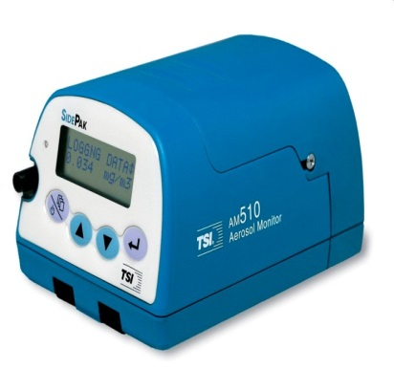
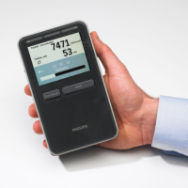
Monitoring equipment
Black Carbon: Aethlabs AE51 microaeth
PM_{2.5}: –TSI Sidepak AM510
Particle number and mean diameter: Phillips Aerasense

Slide 9
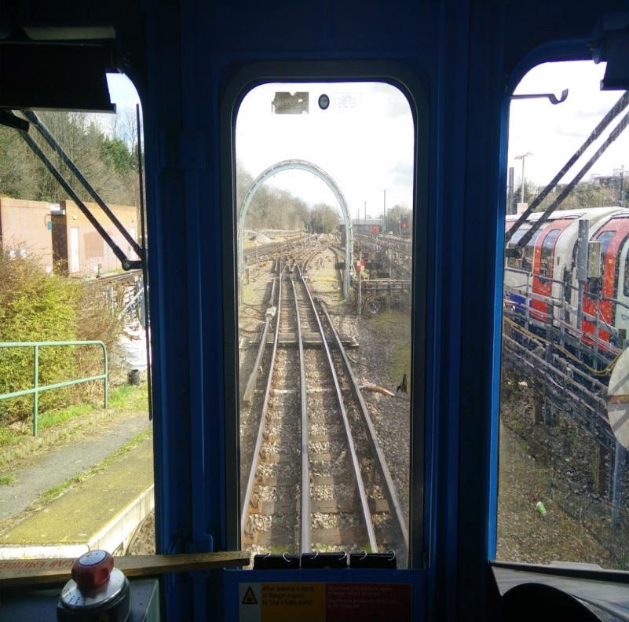
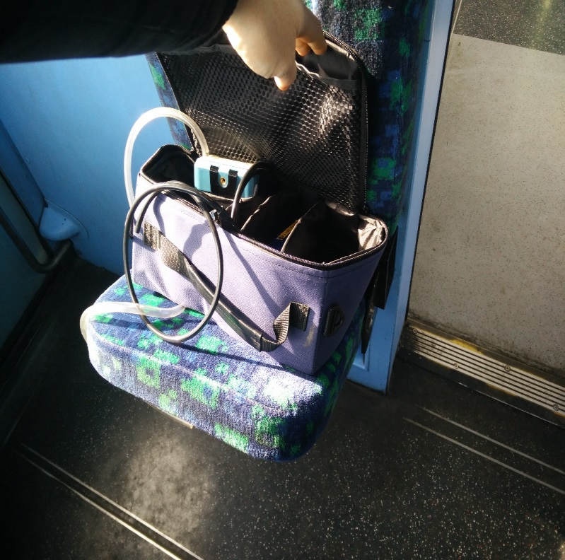
Sampling location
Two sets of monitoring units:
1 set in carriage on seat
1 set in driver’s cab (BC and PM_{2.5} only)

Slide 10
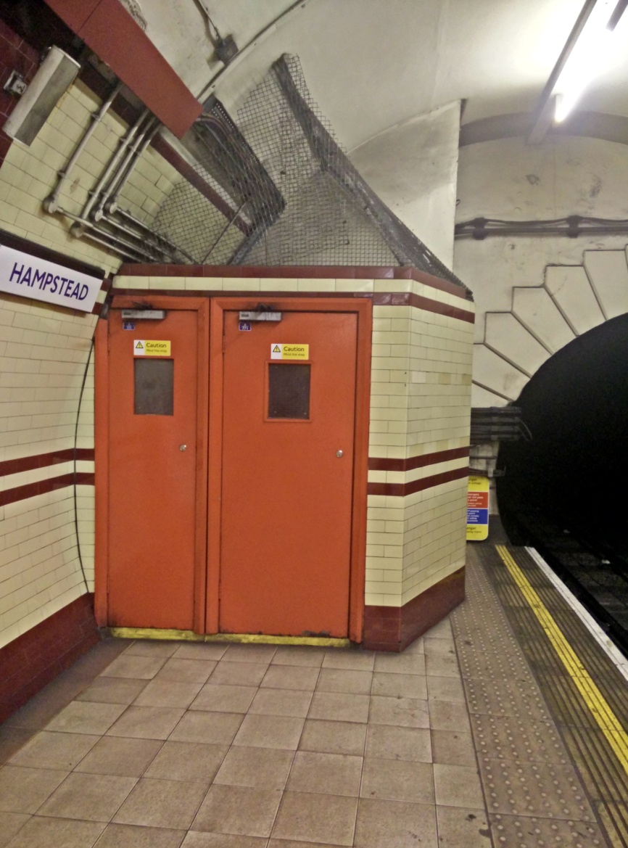
Composition and calibration
Additional platform monitoring at a deep station (Hampstead) using reference monitors planned
Chemical composition (EC, OC, metals…)
Calibration of optical sensors (TSI Sidepak and Aethlabs AE51)
abrasion PM vs exhaust PM reflectance
black carbon vs black/brown iron absorption

Slide 11
Sampling timetable
Line | Start | End | Duration
Victoria | 2014-12-08 09:03 | 2014-12-08 10:40 | 97 minutes
Circle | 2014-12-10 10:47 | 2014-12-10 13:27 | 160 minutes
Northern | 2014-12-16 08:07 | 2014-12-16 12:13 | 246 minutes
Bakerloo | 2015-02-04 08:07 | 2015-02-04 10:03 | 116 minutes
Jubilee | 2015-02-17 09:40 | 2015-02-17 13:53 | 253 minutes
District | 2015-03-03 10:07 | 2015-03-03 13:28 | 201 minutes
Piccadilly | 2015-03-17 09:25 | 2015-03-17 12:50 | 205 minutes
Docklands Light Railway | 2015-04-01 10:17 | 2015-04-01 14:35 | 258 minutes
Metropolitan | 2015-04-09 08:15 | 2015-04-09 12:30 | 255 minutes
Central | 2015-04-22 09:56 | 2015-04-22 13:36 | 222 minutes
 |  | Total | 34 hours
Platform monitoring planned for May/June 2015

Slide 12
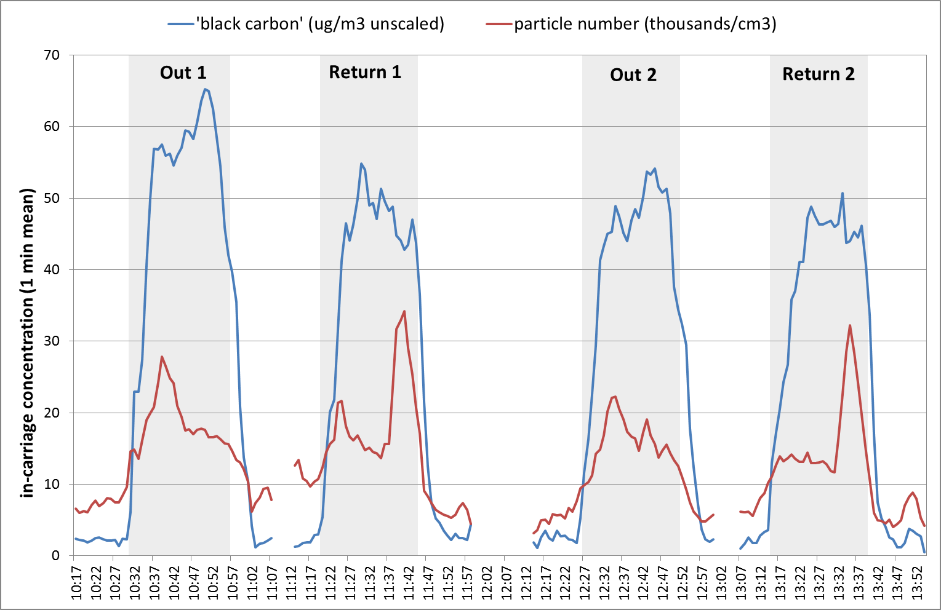
Results – time series
Notes:
Jubilee line - Two journeys full length of line out and back. Central underground section highlighted in grey.
Consistency between four repeat measurements. A lag of a few minutes once above ground for levels to drop.
Reason for spike in pnum around Baker Street/Green Park not clear.

Slide 13
LU vs. Ambient
LU includes over-ground, PM_{2.5} and cblk unscaled, pcmn = particle mean diameter in nm
Notes:
– Comparison of mean concentrations between underground monitoring and Ox St 2. Same instruments used, same times of day. LU includes both above ground and below ground, median would be shifted up if just below ground.

Slide 14
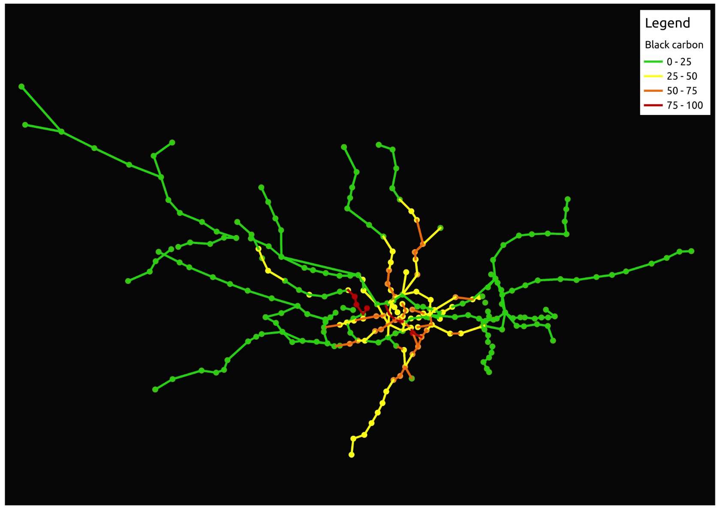
Mapped BC concentrations
Notes:
Red = all on Bakerloo (oldest line):
Maida Vale, Warwick Avenue, Charing Cross, Lambeth North, Edgware Road

Slide 15
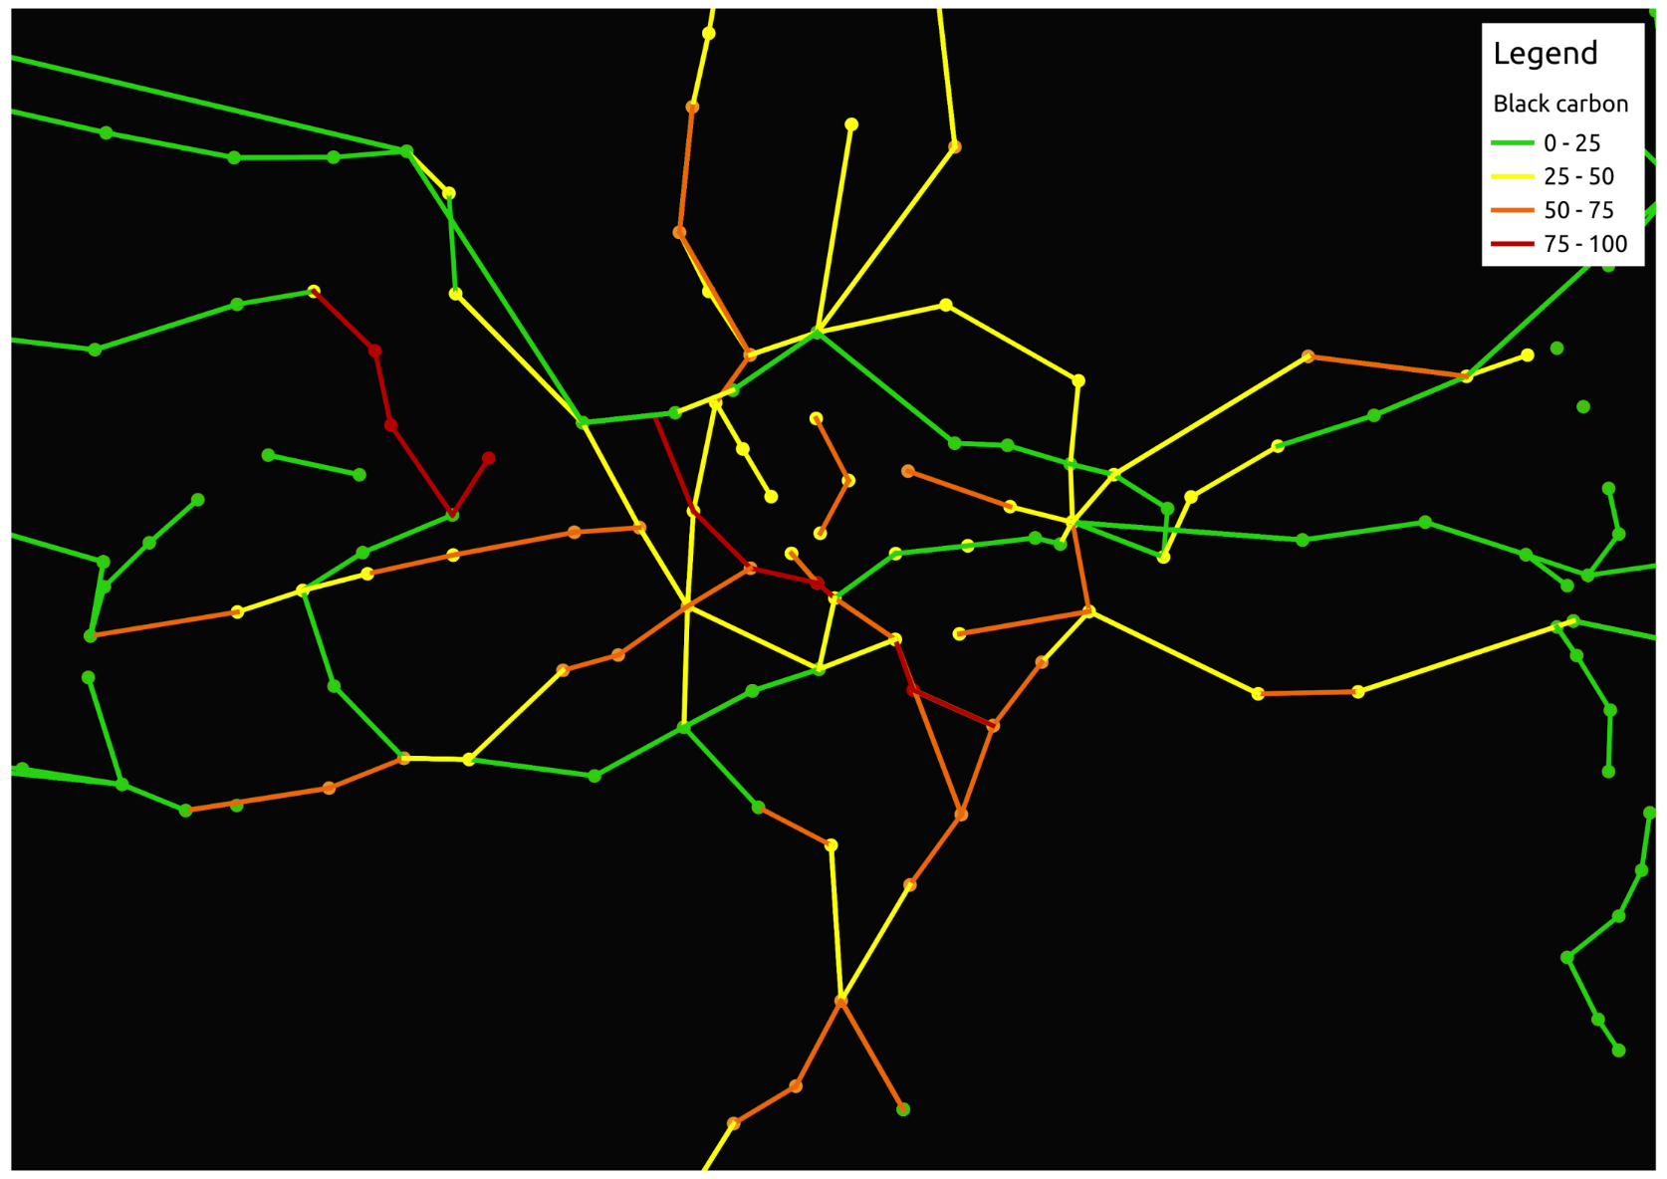
Mapped BC (central London)
Notes:
Red = all on Bakerloo (oldest line):
Maida Vale, Warwick Avenue, Charing Cross, Lambeth North, Edgware Road

Slide 16
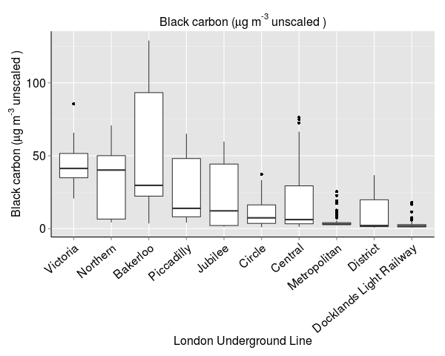
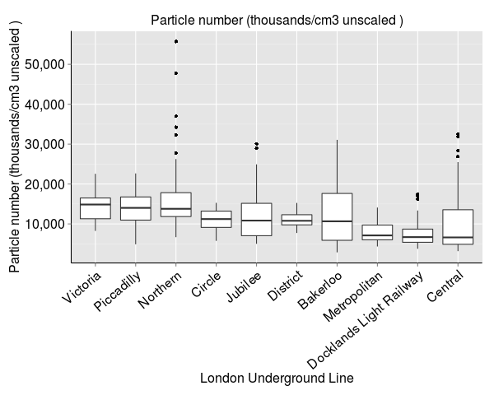
Comparison of lines
Ranking largely dependent on what proportion of line is underground
Evidence that age and construction method is also a factor

Slide 17
Results Summary
PM concentrations show consistent variation in levels with higher levels at deeper stations.
Underground unscaled BC (black iron?) and PM_{2.5} concentrations far exceeded ambient
PNum lower than kerbside, but higher than background, pdia larger but still in nm range.
Drops to ambient levels within c. 5 mins when travelling above ground.
Levels in carriage generally higher then in driver’s cab, likely due to opening doors.

Slide 18
Conclusions
Travel on the underground represents a significant component of daily PM exposure for many residents of large cities
This is not an occupational health issue; everyone is exposed, including sensitive populations:
>1.2 billion passengers use the network every year
45% of the LU network is underground

Slide 19
Conclusions
Light scattering personal monitoring equipment needs a specific underground calibration factor.
This calibration is increasingly important for personal exposure / exposomics studies.
LU calibration factors should be transferrable to other underground systems.

Slide 20
Ongoing work
Variation between lines (build and carriage design)
Line depth
Uncovered vs. tunnels
Driver vs. passenger
Integration into time-activity exposure model
Visualisation of results

Slide 21
Outstanding questions
What is the health significance of short very high exposures?
What is the toxicity of this PM? (RAPTES)
What can be done to decrease exposure?
Are there conflicting public transport messages?

Slide 22

Contact King’s
Frank J. Kelly
Professor of Environmental Health
frank.kelly@kcl.ac.uk

Slide 23
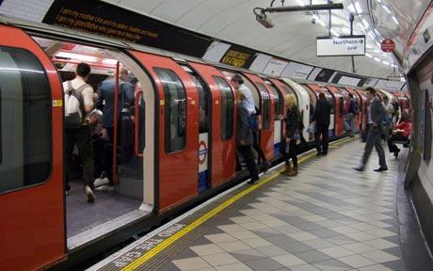

Slide 24


Slide 25
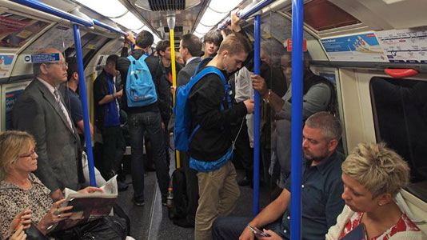

Slide 26
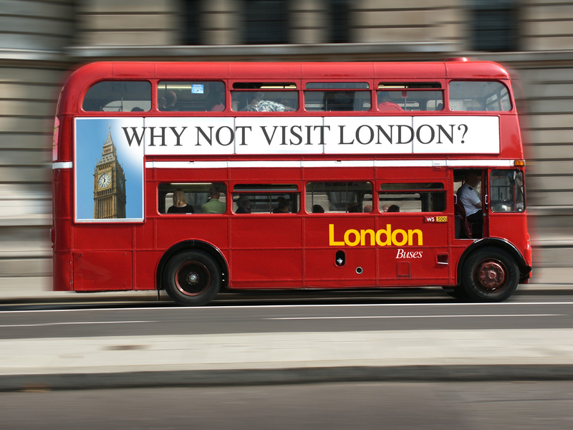

Slide 27
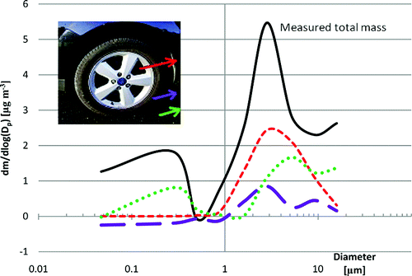
Non-exhaust Traffic Particles
Harrison et al, EST, 2012

Slide 28
